Slide 1
PYTHON
IF ... ELSE

Slide 2
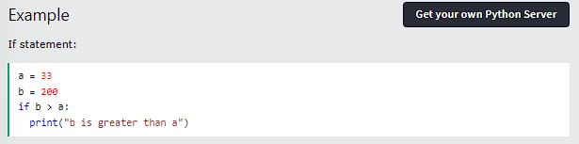
PYTHON CONDITIONS AND IF STATEMENTS
Python supports the usual logical conditions from mathematics:
Equals: a == b Not Equals: a != b Less than: a < b
Less than or equal to: a <= b Greater than: a > b
Greater than or equal to: a >= b
These conditions can be used in several ways, most commonly in "if statements" and loops. An "if statement" is written by using the if keyword.

Slide 3
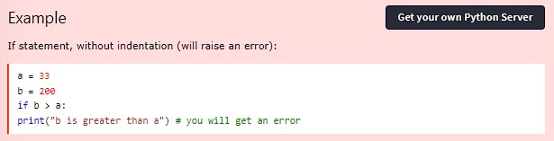
In this example we use two variables, a and b, which are used as part of the if statement to test whether b is greater than a. As a is 33, and b is 200, we know that 200 is greater than 33, and so we print to screen that "b is greater than a".
IDENTATION
Python relies on indentation (whitespace at the beginning of a line) to define scope in the code. Other programming languages often use curly-brackets for this purpose.

Slide 4
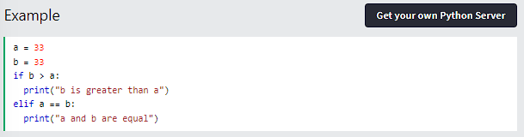
ELIF
The elif keyword is Python's way of saying "if the previous conditions were not true, then try this condition".
In this example a is equal to b, so the first condition is not true, but the elif condition is true, so we print to screen that "a and b are equal".

Slide 5
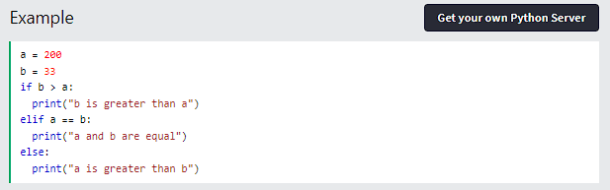
ELSE
The else keyword catches anything which isn't caught by the preceding conditions.

Slide 6
In this example a is greater than b, so the first condition is not true, also the elif condition is not true, so we go to the else condition and print to screen that "a is greater than b".
You can also have an else without the elif:

Slide 7
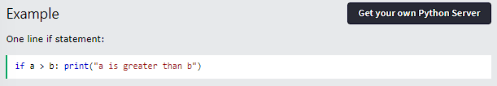
SHORT HAND IF
If you have only one statement to execute, you can put it on the same line as the if statement.

Slide 8
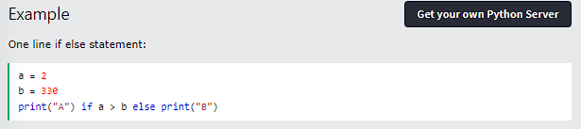
SHORT HAND IF ... ELSE
If you have only one statement to execute, one for if, and one for else, you can put it all on the same line:

Slide 9
AND
If you have only one statement to execute, you can put it on the same line as the if statement.

Slide 10
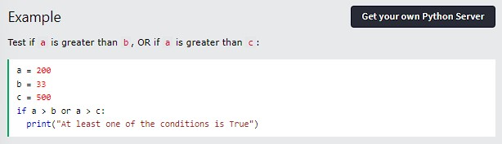
OR
The or keyword is a logical operator, and is used to combine conditional statements:

Slide 11
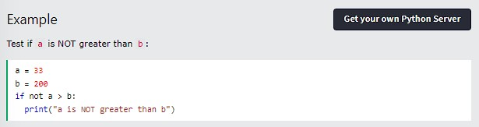
NOT
The not keyword is a logical operator, and is used to reverse the result of the conditional statement:

Slide 12
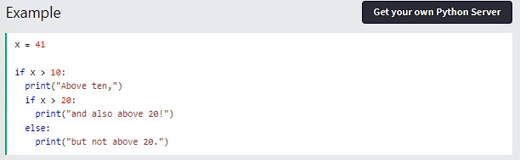
NESTED IF
You can have if statements inside if statements, this is called nested if statements.

Slide 13
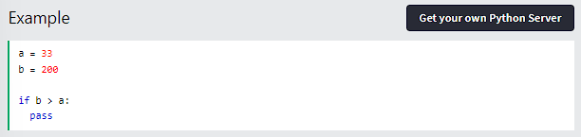
THE PASS STATEMENT
if statements cannot be empty, but if you for some reason have an if statement with no content, put in the pass statement to avoid getting an error.

Slide 14
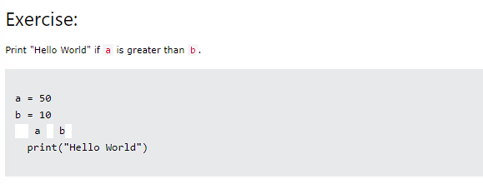
TEST YOURSELF WITH EXERCISES

Slide 15
THANK YOU

